Slide 1
Algebraic properties of matrices
Read the summary. Solve the 2 questions at the end of the document

Slide 2
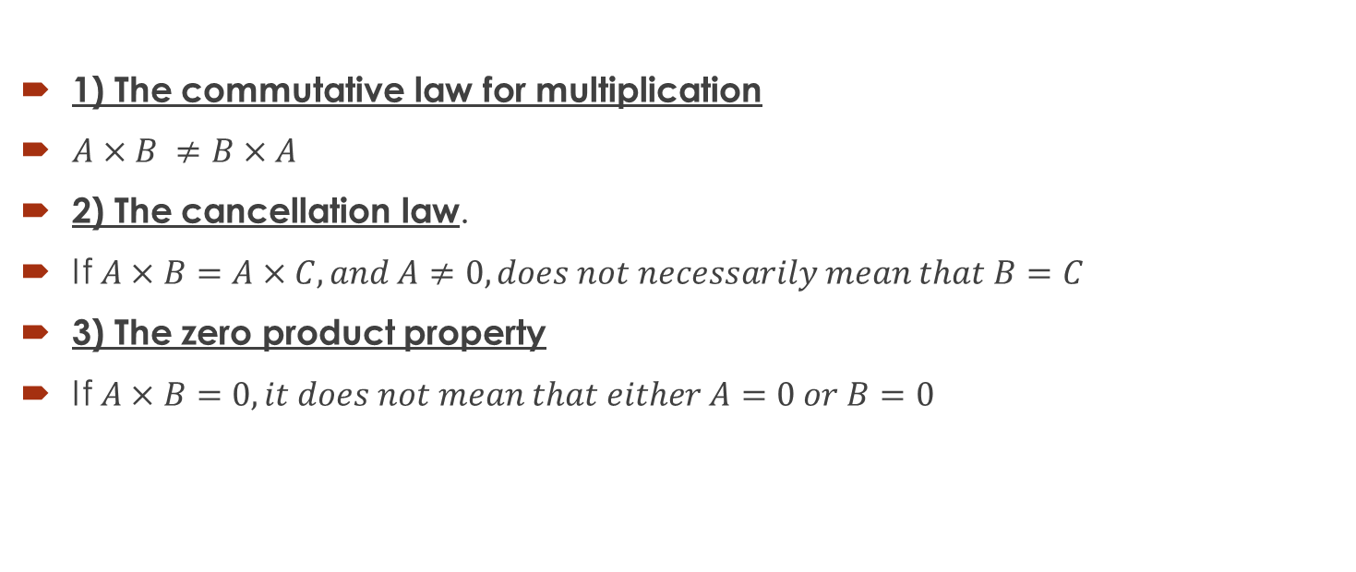
NOT TRUE for matrices
1) The commutative law for multiplication
$A×B ≠B×A$
2) The cancellation law.
If $A×B=A×C, and A≠0, does not necessarily mean that B=C$
3) The zero product property
If $A×B=0, it does not mean that either A=0 or B=0$

Slide 3

The identity matrix
The identity matrix has the role of 1. It will not change a matrix when multiplied by it.
Definition. An identity matrix is a square matrix with 1’s on the main diagonal and zeroes elsewhere.
Examples:
$\left[\begin{aligned}1 0 0 \\ 0 1 0 \\ 0 0 1\end{aligned}\right]$ ; $\left[\begin{aligned}1 0 0 0 \\ 0 1 0 0 \\ 0 0 1 0 \\ 0 0 0 1\end{aligned}\right]$

Slide 4

The inverse of a matrix
If A is a square matrix and if a matrix B can be found such that AB= I, then matrix A is said to be invertible (or non-singular) and matrix B is called the inverse of A. If no such matrix B can be found, then A is said to be singular.
$A A^{−1}=A^{−1} A=I$

Slide 5

The inverse of a 2 x 2 matrix
The matrix
A = $\left[\begin{aligned}a b \\ c d\end{aligned}\right]$is invertible if and only if $ad−bc≠0$ in which case the inverse is given by the formula:
$$A^{−1}=\frac{1}{ad−bc} \left[\begin{aligned} d −b \\ −c a\end{aligned}\right]$$

Slide 6
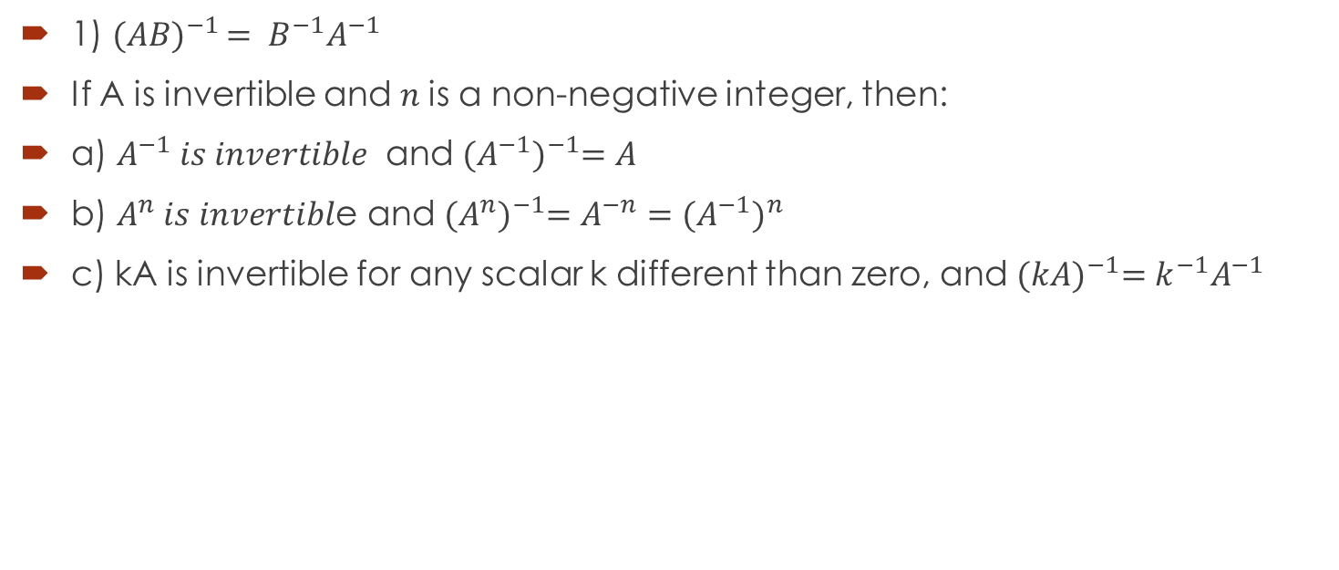
Properties of inverses
1) ${(AB)}^{−1 }= B^{−1}A^{−1}$
If A is invertible and $n$is a non-negative integer, then:
a) $A^{−1} is invertible$ and ${(A^{−1})}^{−1}=A$
b) $A^{n} is invertibl$e and ${(A^{n})}^{−1}=A^{−n}={(A^{−1})}^{n}$
c) kA is invertible for any scalar k different than zero, and ${(kA)}^{−1}=k^{−1}A^{−1}$

Slide 7
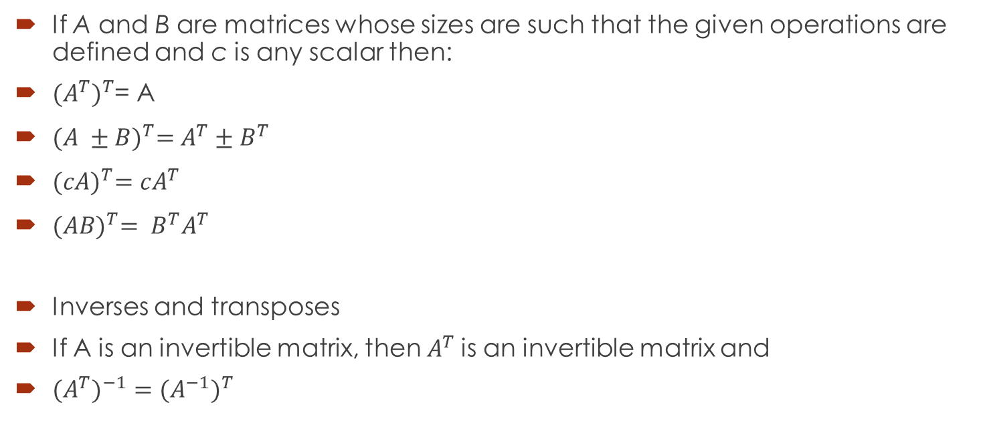
Properties of transposes
If A and B are matrices whose sizes are such that the given operations are defined and c is any scalar then:
${{(A}^{T})}^{T}$= A
${(A ±B)}^{T}=A^{T}±B^{T}$
${(cA)}^{T}=cA^{T}$
${(AB)}^{T}= B^{T}A^{T}$
Inverses and transposes
If A is an invertible matrix, then $A^{T}$is an invertible matrix and
${{(A}^{T})}^{−1}={{(A}^{−1})}^{T}$

Slide 8

Question1
Find the inverse of the following matrix:
$A= \left[\begin{aligned}3 −5 \\ 2 7\end{aligned}\right]$

Slide 9

Question 2
Find A given the information:
${({3A}^{T})}^{−1}=\left[\begin{aligned}−3 0 \\ 1 5\end{aligned}\right]$

